Slide 1
Ελλάδα – Greece – Hellas
the country of light

Slide 2
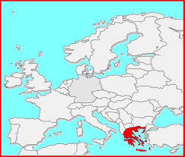
southeastern Europe
southern tip of the Balkans
crossroads of Europe, Asia, Africa.

Slide 3
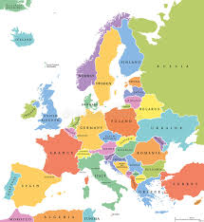
Albania
North Macedonia
Bulgaria
Turkey

Slide 4
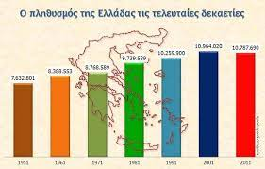
Population
10,72 million
people

Slide 5
The flag
has nine horizontal
white and blue lines
and a white cross.
The nine lines correspond to the greek syllables
of the phrase
“freedom or death”.

Slide 6
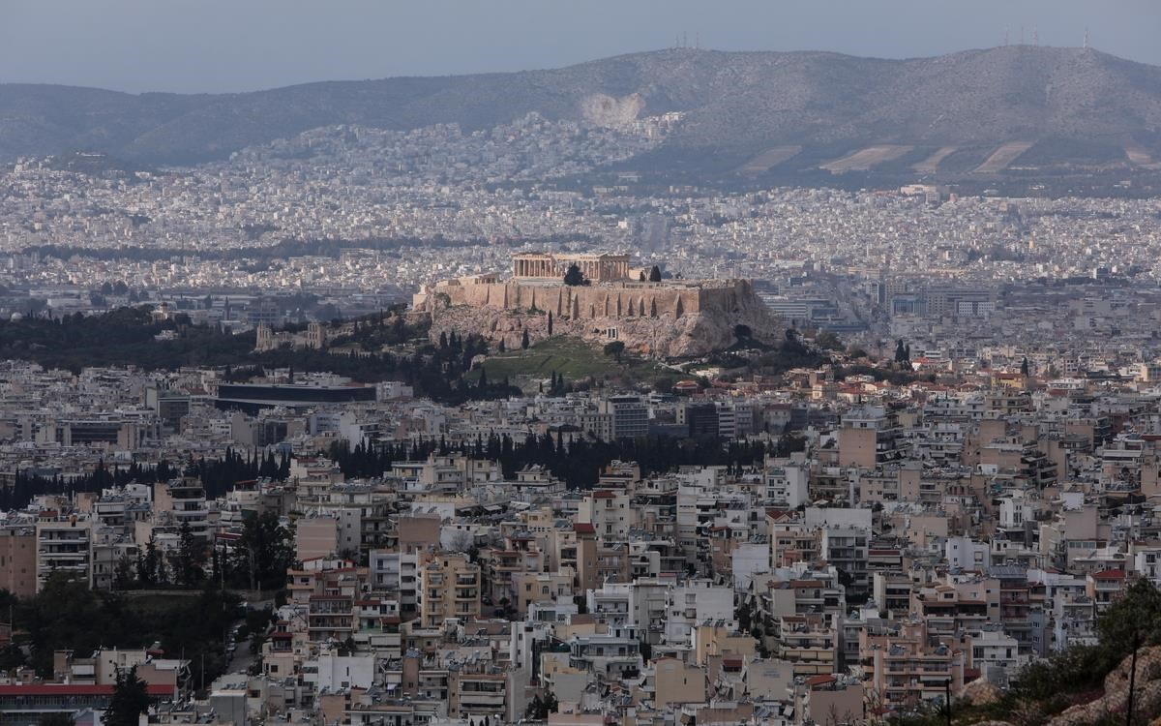
is the capital city of Greece
Athena - Athens

Slide 7
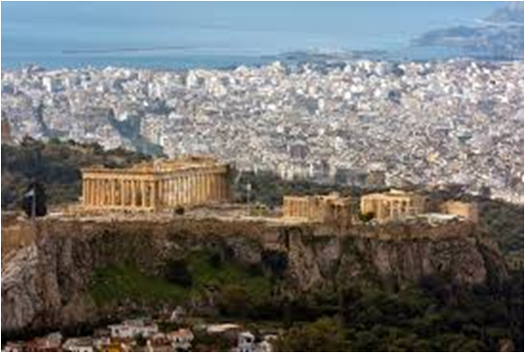
The goddess Athena fought against Poseidon for the privilege
to protect the city.

Slide 8
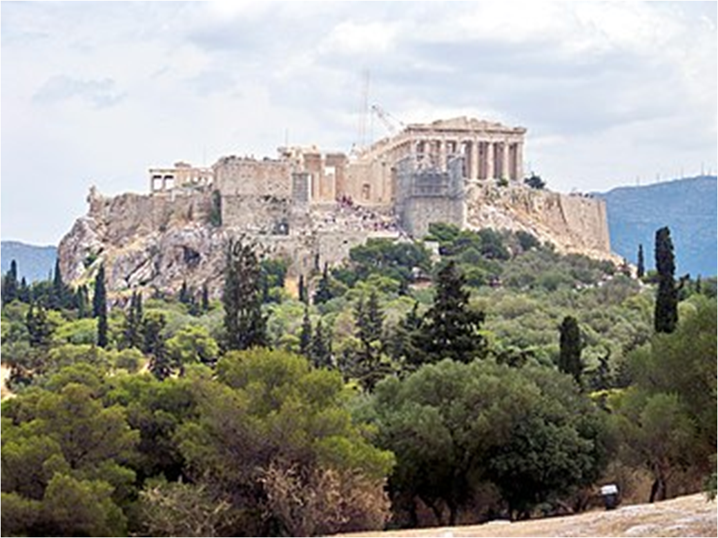
To honor her
the Athenians
built the Acropolis and
the Parthenon

Slide 9
The Olympic Games
The ancient Olympic Games
were Pan-Hellenic Games
of Ancient Greece.
They were held in honor of Zeus,
every four years, in Olympia,
from 776 BC until 393 AD
The first Modern Olympic Games were held in Athens in 1896.

Slide 10
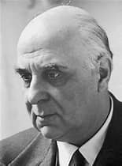
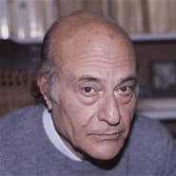
Georgios Seferis
Odysseas Elytis
Greek poets awarded the Nobel Prize

Slide 11
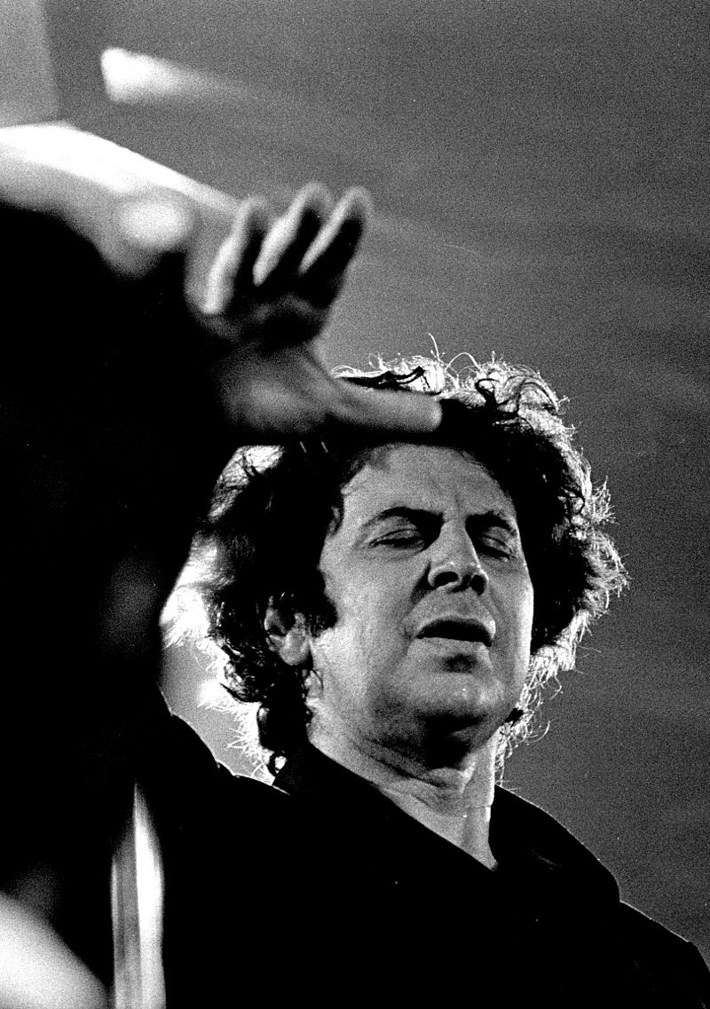
Mikis Theodorakis
One of the most important contemporary
Greek composers

Slide 12
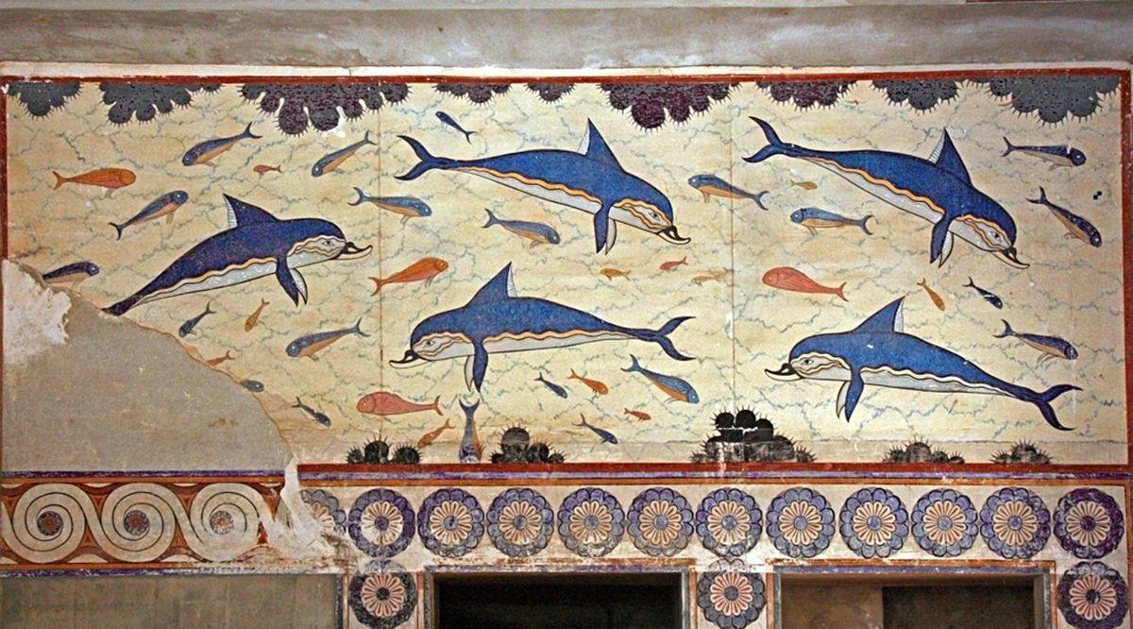
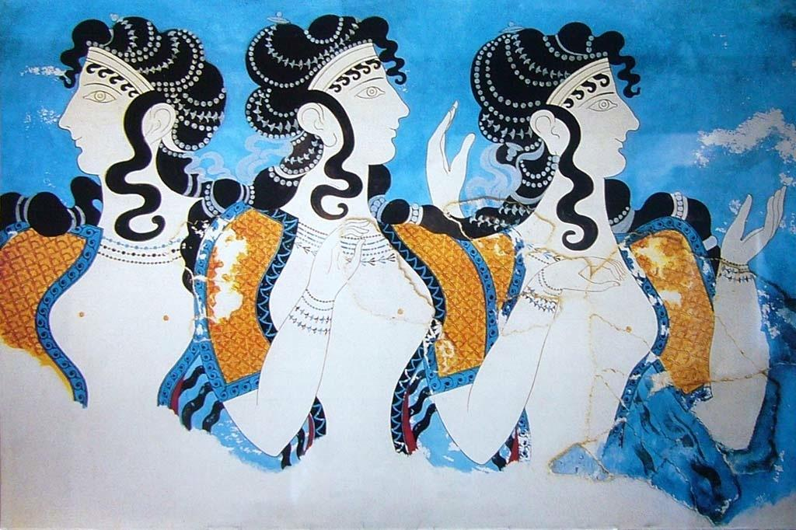
Samples of ancient greek art
Nature
in the Minoan civilization
The Blue Ladies

Slide 13
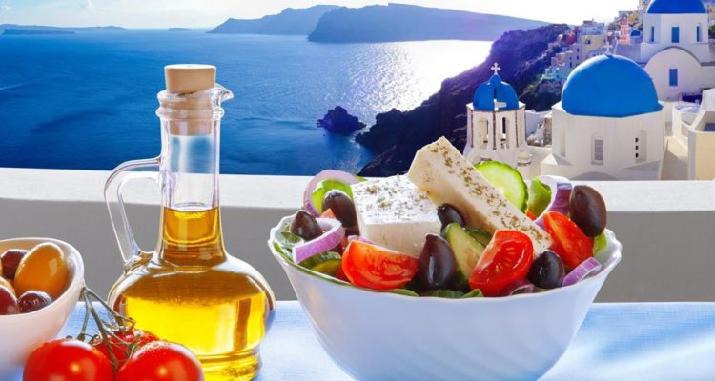
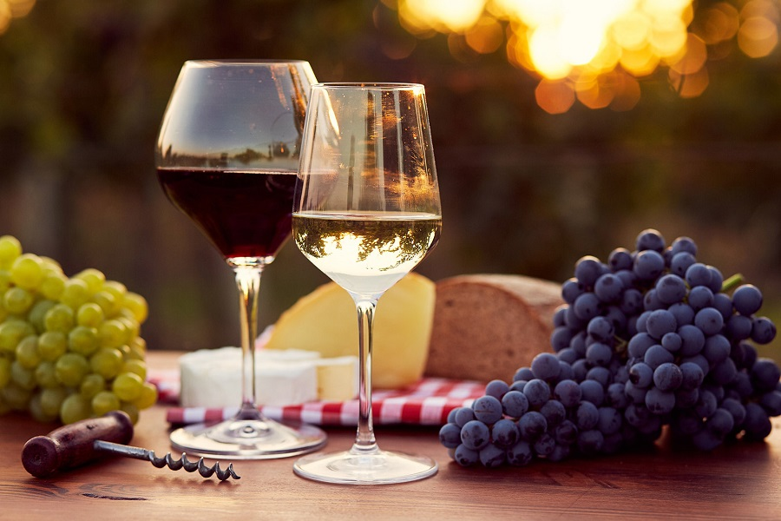
Products of the land
Oil, olives, feta cheese and tomatoes
Grapes and wine

Slide 14
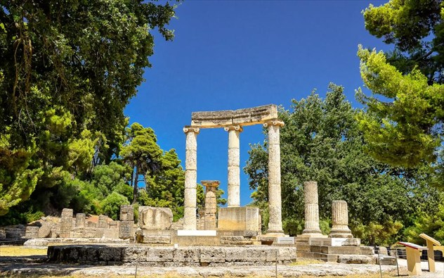
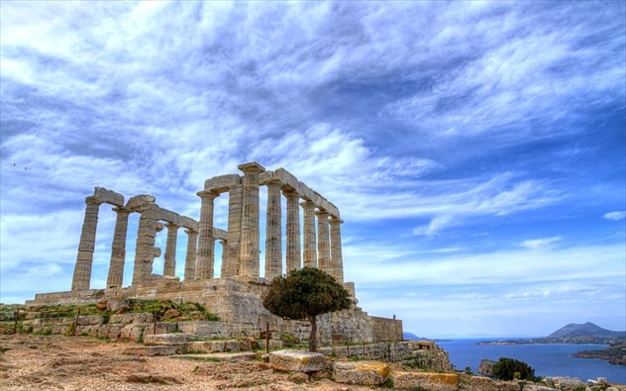
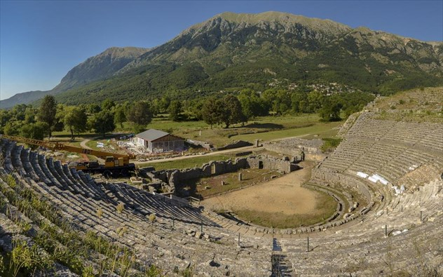
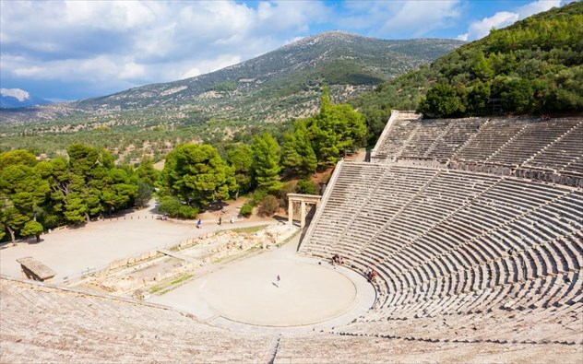
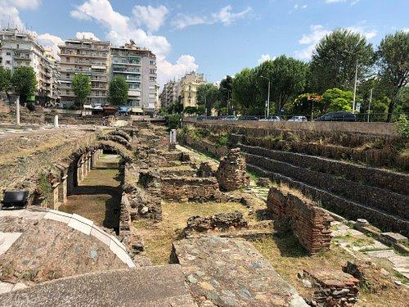
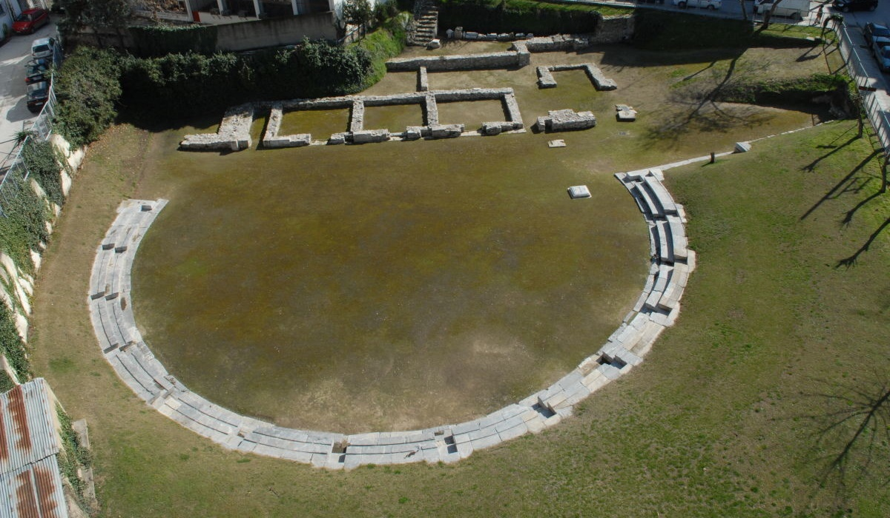
Olympia
Ancient temple of Poseidon, Sounio
Ancient theater of Dodoni, Ioannina
Roman market
Thessaloniki
Ancient theatre of Epidavros
2nd Ancient Theater of Larissa
Famous archaeological sites

Slide 15
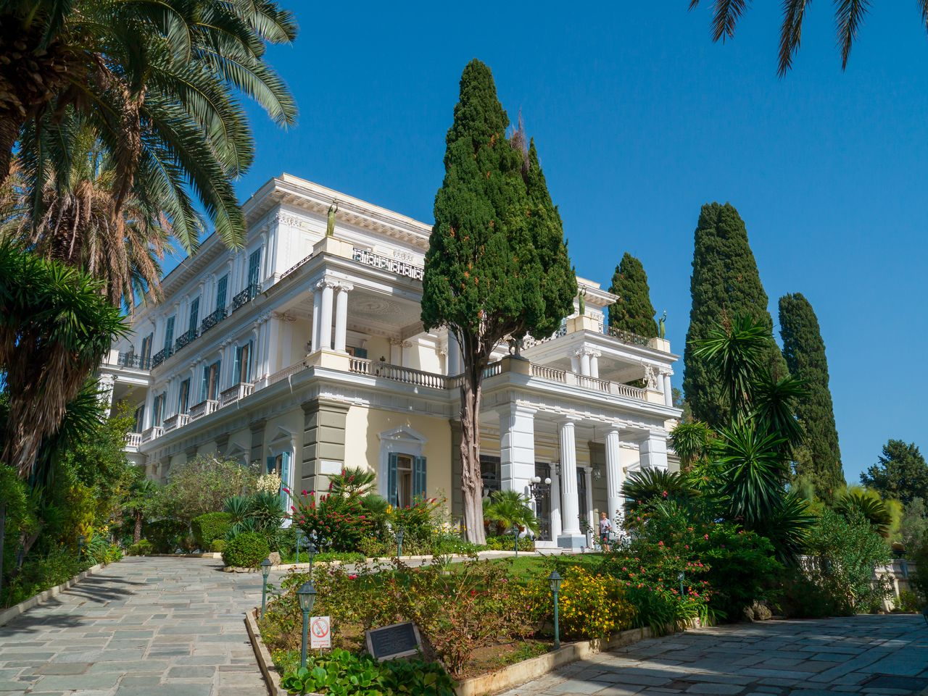
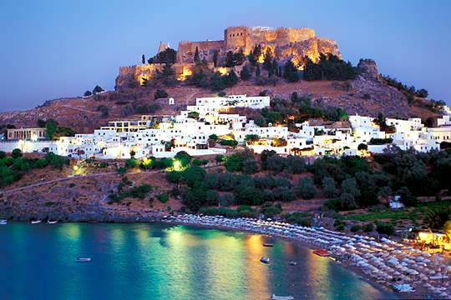
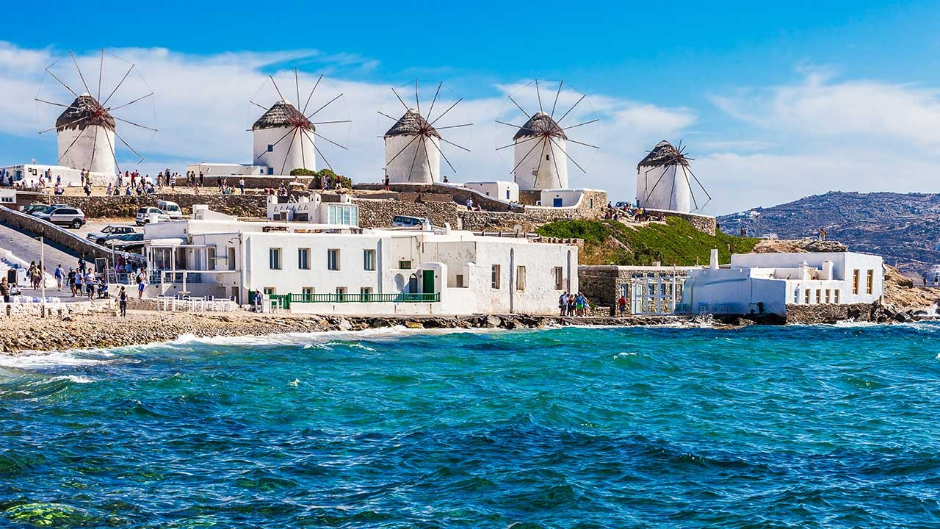
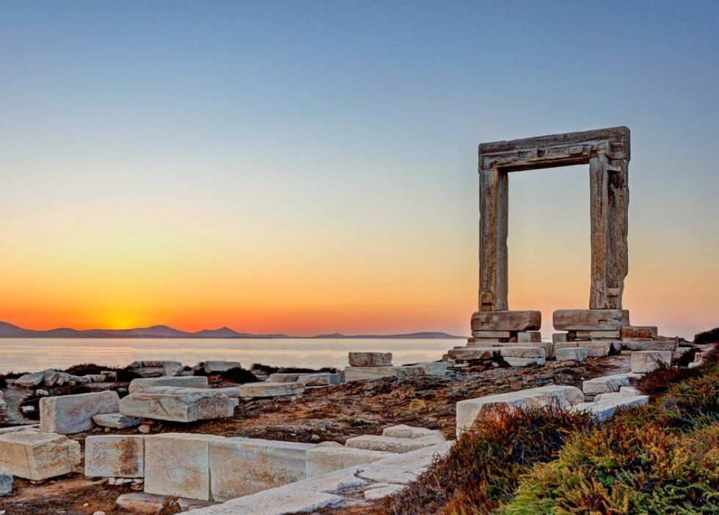
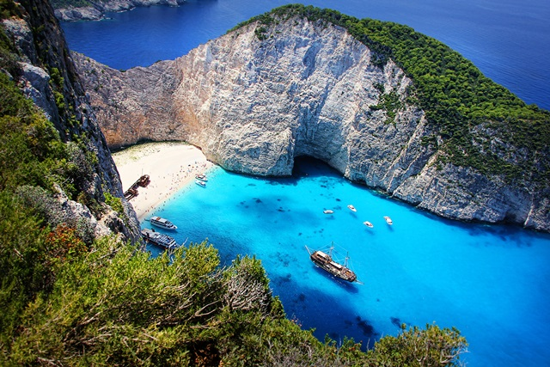
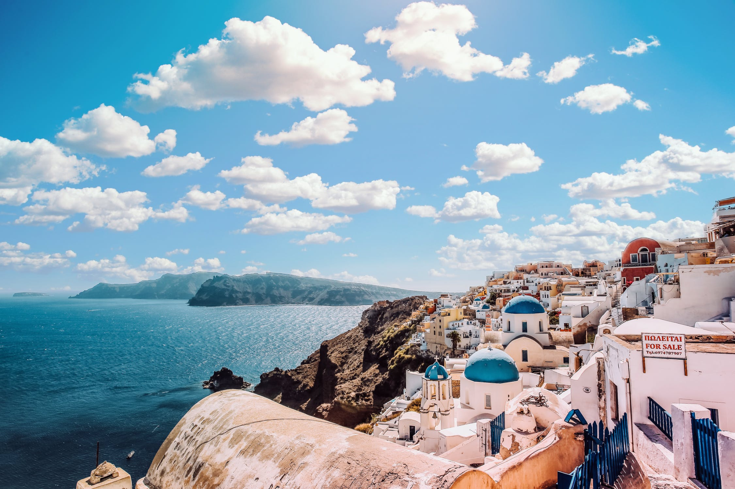
Αchillion, Corfu
Mykonos
Lindos, Rhodes
Portara, Naxos
Zakynthos
Κaldera, Santorini
Beautiful landscapes

Slide 16
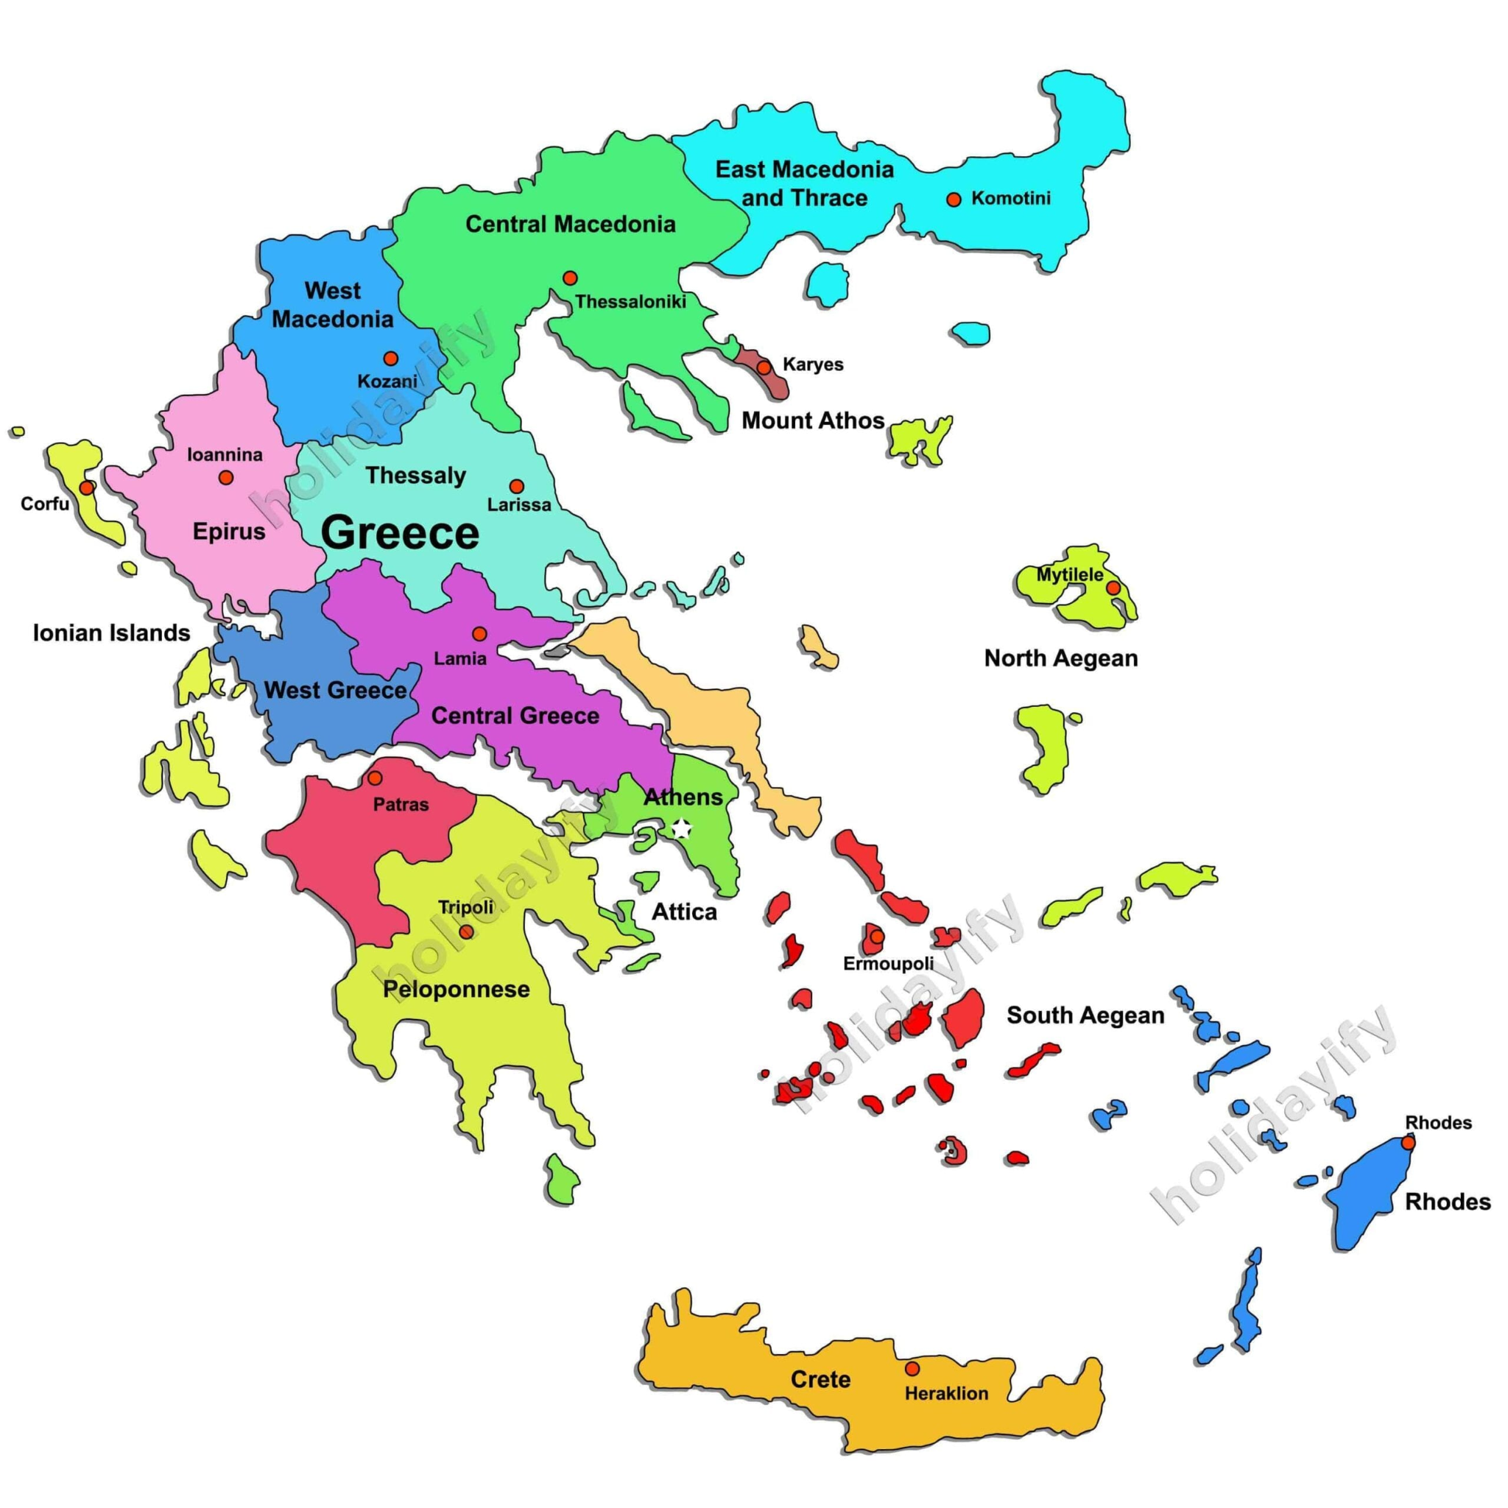
Greece
is divided
in 13 regions

Slide 17
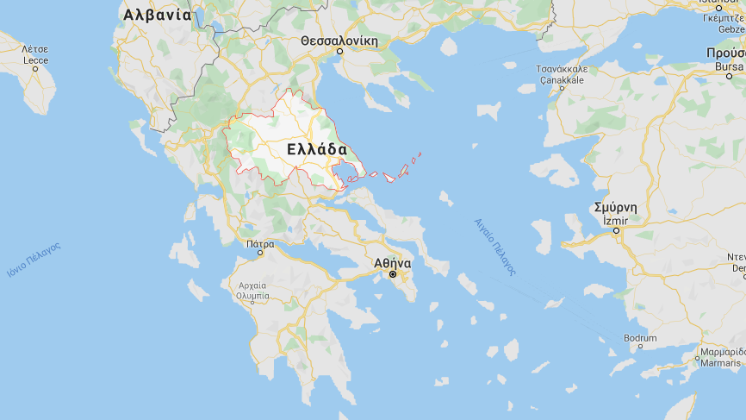
THESSALY, our region

Slide 18
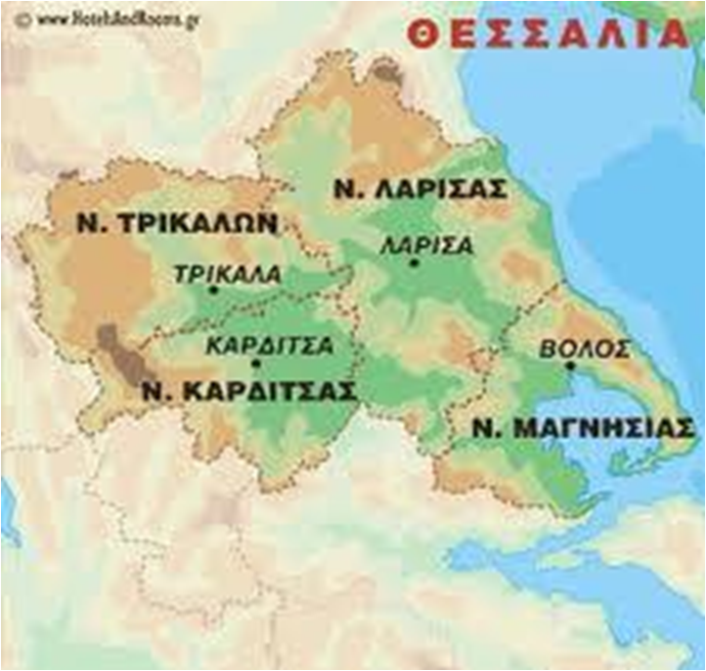
Most of Thessaly is a plain.
The main products are:
Cotton
Wheat
Corn
Tobacco

Slide 19
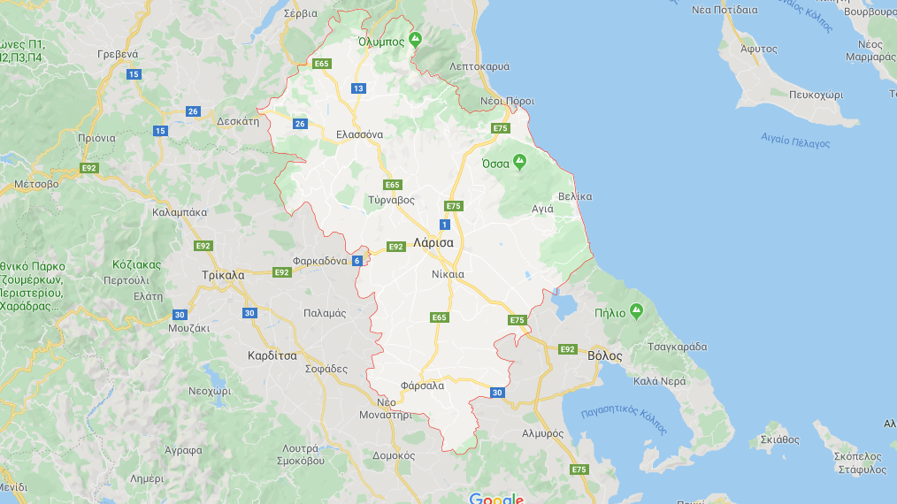
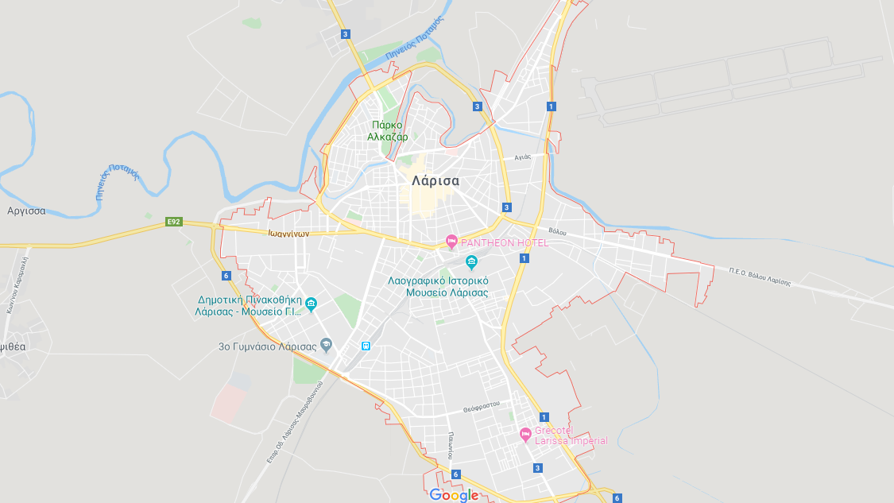
LARISSA, our city

Slide 20
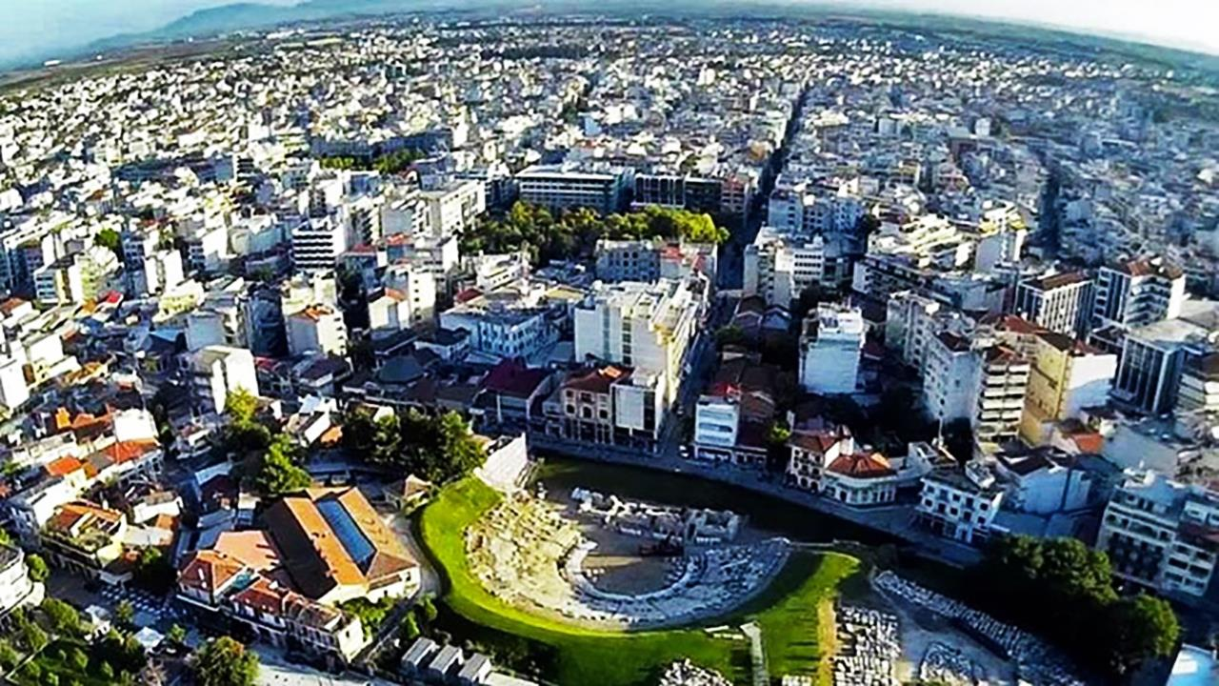
Larissa
Larissa is the capital of the Region of Thessaly.
It is built on both banks of the Pinios River.
Larissa is almost 8,000 years old.
The father of medicine, Hippocrates, lived and died in Larissa.

Slide 21
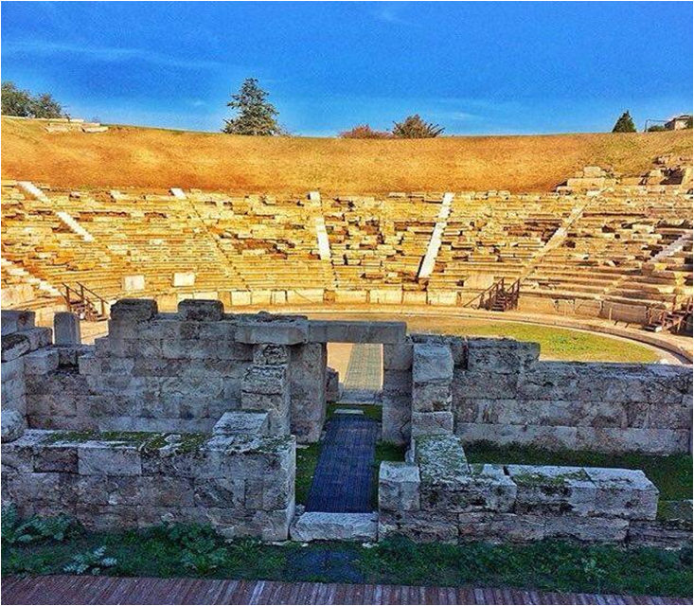
It was built at the end οf the 3rd century BC. It is a typical Hellenistic theatre It is divided into three basic parts: Koilon - orchestra - scene
The first ancient theatre of Larissa

Slide 22
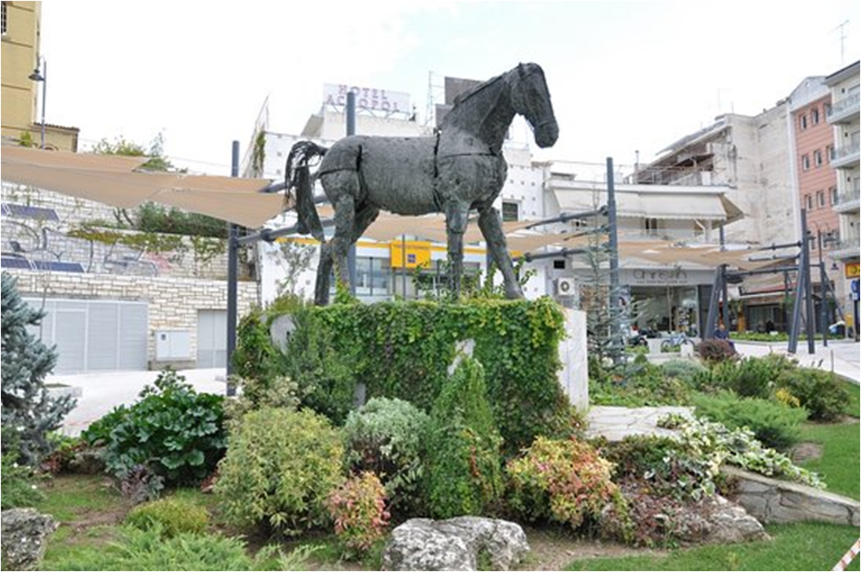
The Thessalian
Horse
Bucephalus,
the horse
of Alexander the Great,
was of the thessalian race
The landmark of the city

Slide 23
Larissa Athletic Union
The colours of the team
are crimson and white
and its emblem is
a horse on its hind legs
The team's nicknames are
‘the Crimsons’ and
‘the Queen of the Plain’

Slide 24
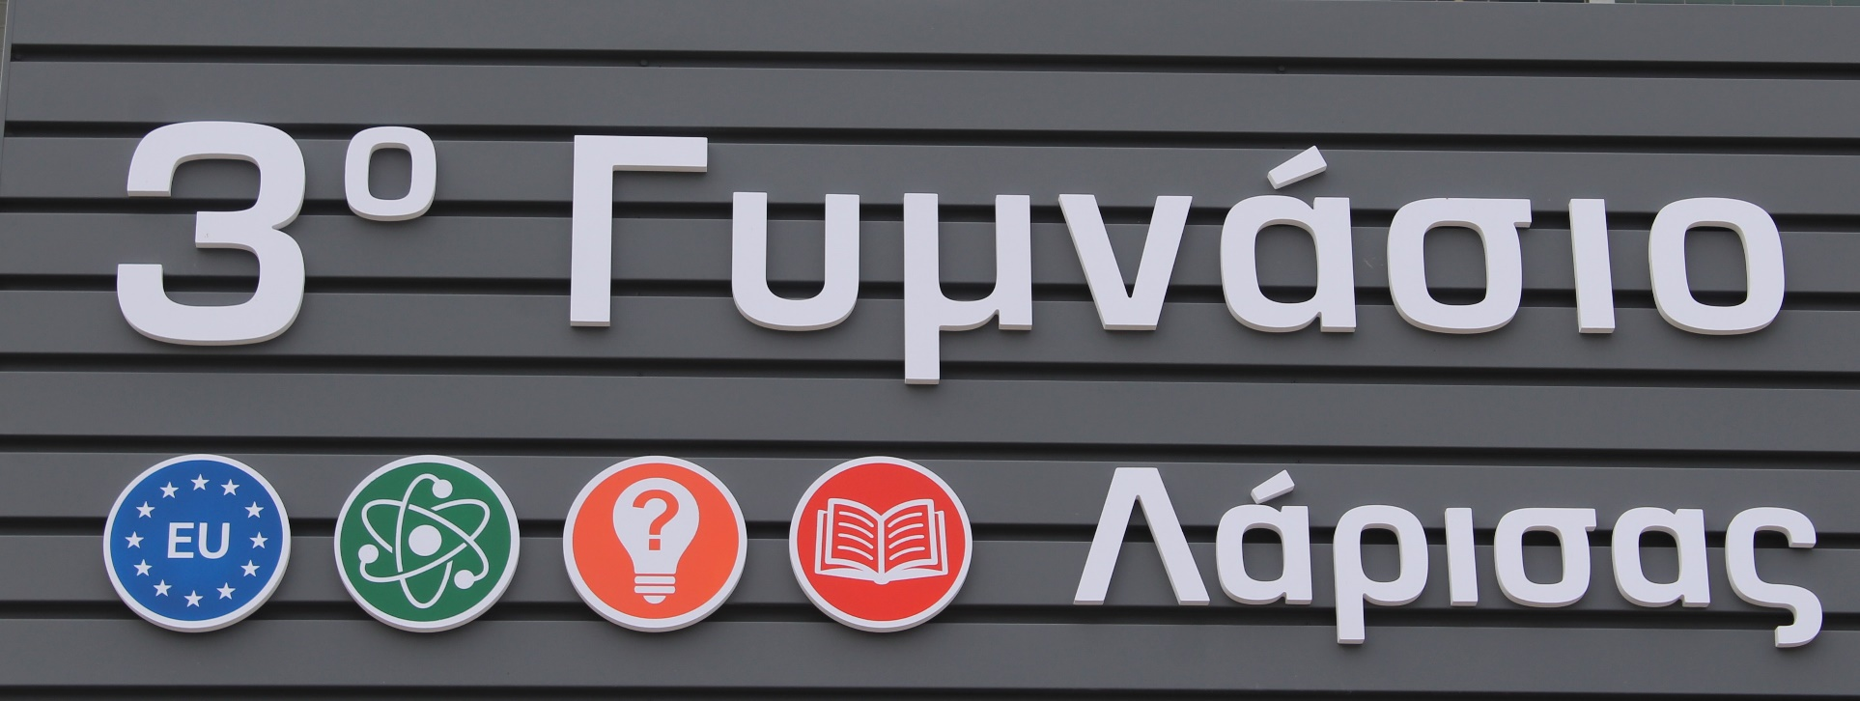
3rd High School of Larissa, Greece
3º Gymnasio Larissas
A short presentation

Slide 25
3rd Gymnasio Larissas
Our school

Slide 26
A secondary public school education is compulsory in Greece up to the age of 15
Our school was founded in 1976
3 grades
362 students
32 teachers
afternoon classes for 60 refugee students

Slide 27
The subjects we learn
Science: Physics/Math/Chemistry/Biology
Computer Studies/Technology
Geography/History/ Religion
Ancient and modern Greek language and literature
Foreign languages (English/French/German)
Music/ Arts
Home economics/ Civil education
Physical Education/Sports

Slide 28
Refugee students have afternoon classes either attend morning classes

Slide 29
School activities Ecology

Slide 30
We run a campaign to collect plastic caps.
We learn how important recycling is for a sustainable living and we practice active citizenship.
Every year we buy and donate a wheelchair with the collected caps
Plastic caps collection

Slide 31
‘Planting trees’ campaign

Slide 32
22/4/2018
We planted more than 400 trees !

Slide 33
Stomio beach 2017-18
Beach cleanups
Part of a European and National campaign

Slide 34
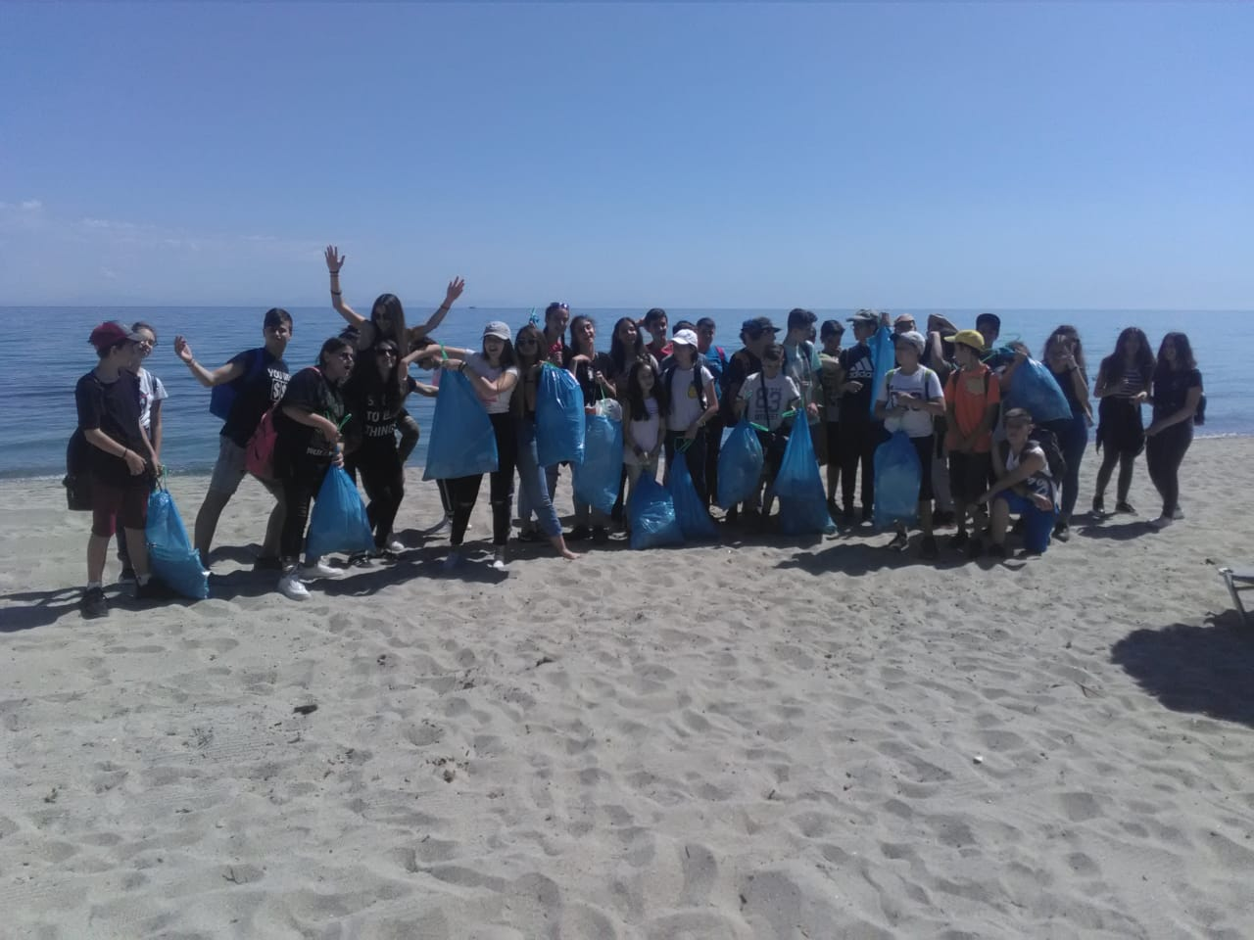
Platamonas beach 2018-19

Slide 35
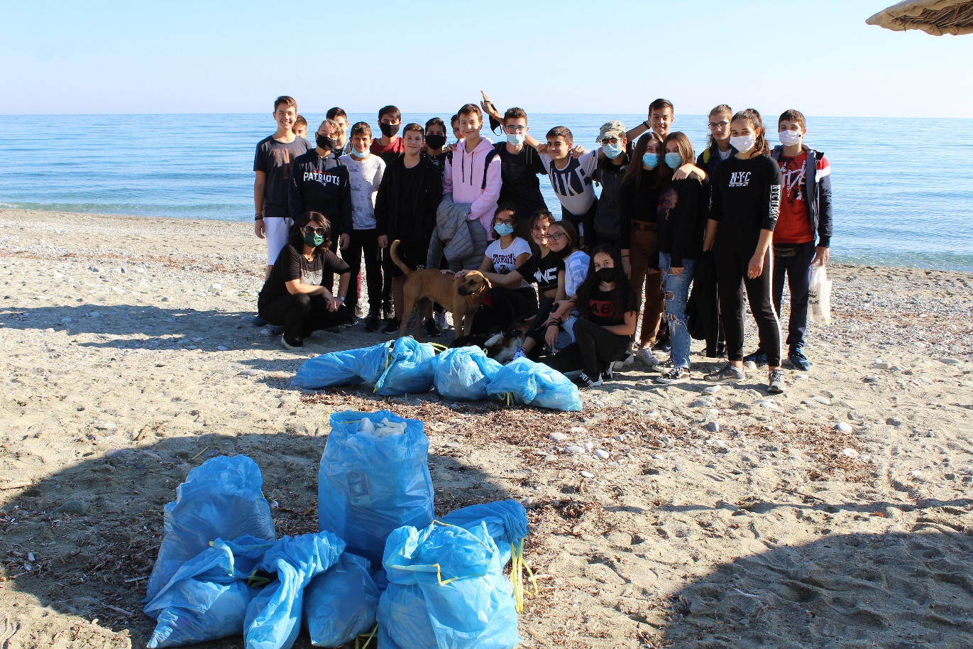
Leptokarya beach
2020-21

Slide 36
The ‘Upcycle project’

Slide 37
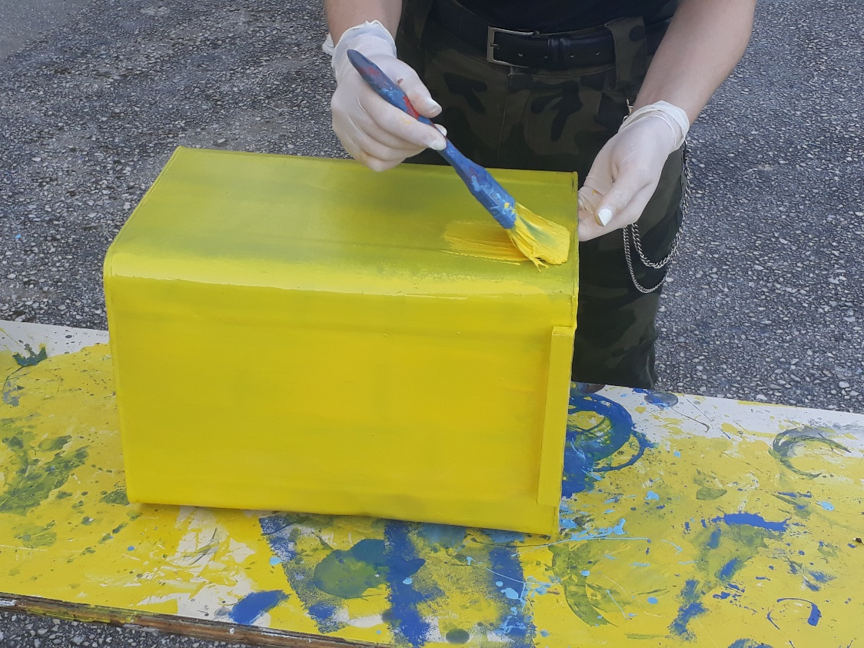
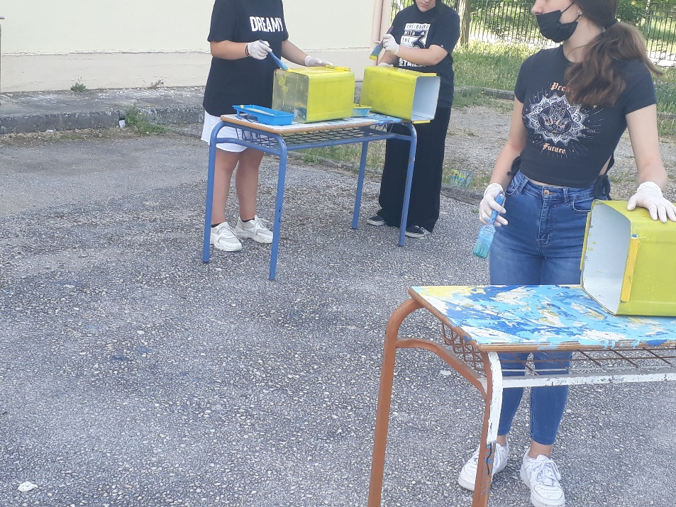
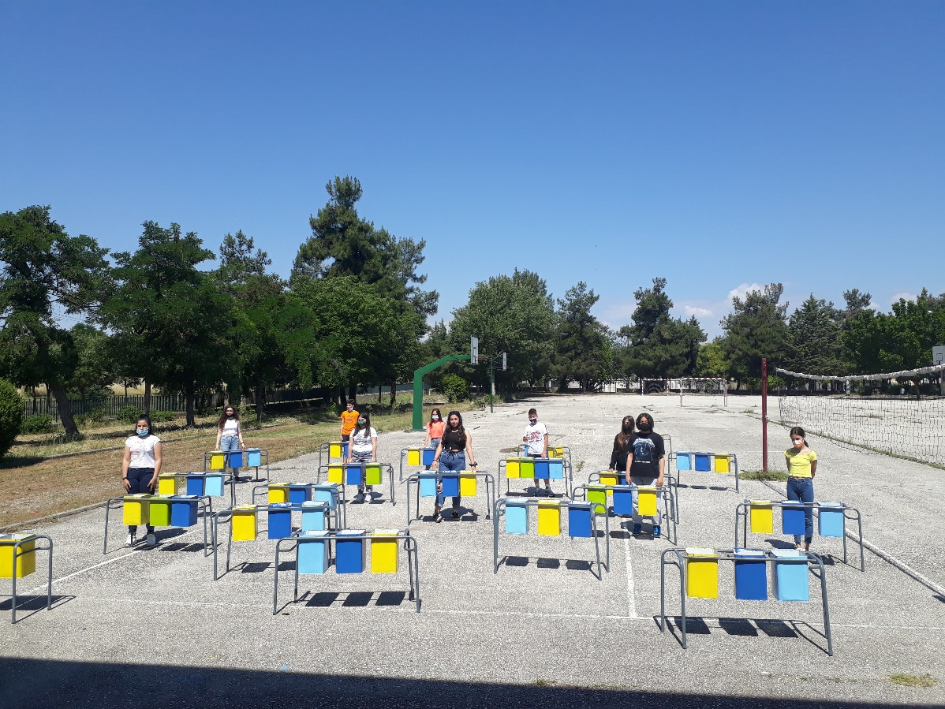
We turned
old desks
and used tins
into
recycling bins

Slide 38
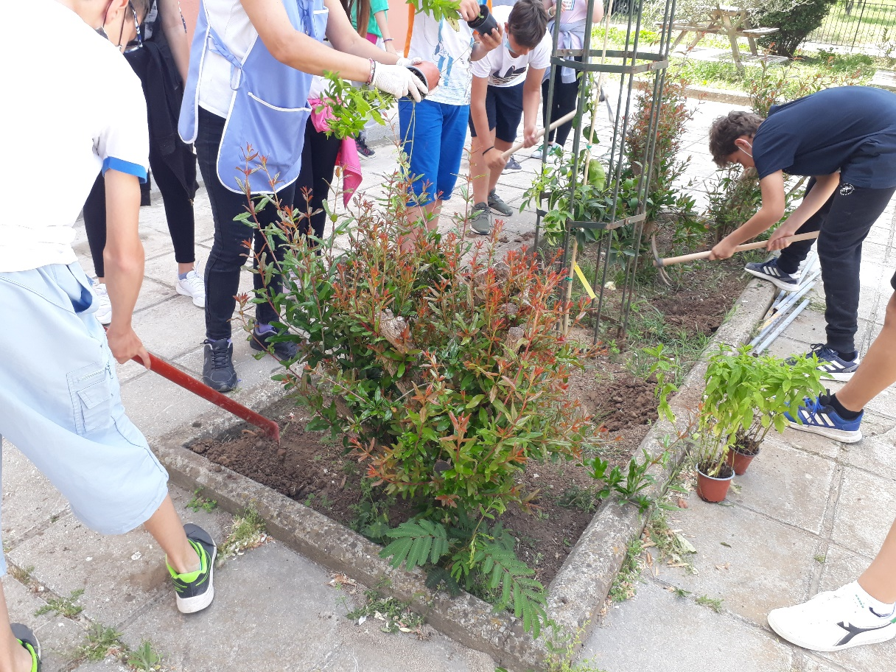
School gardens
Planting decorative plants

Slide 39
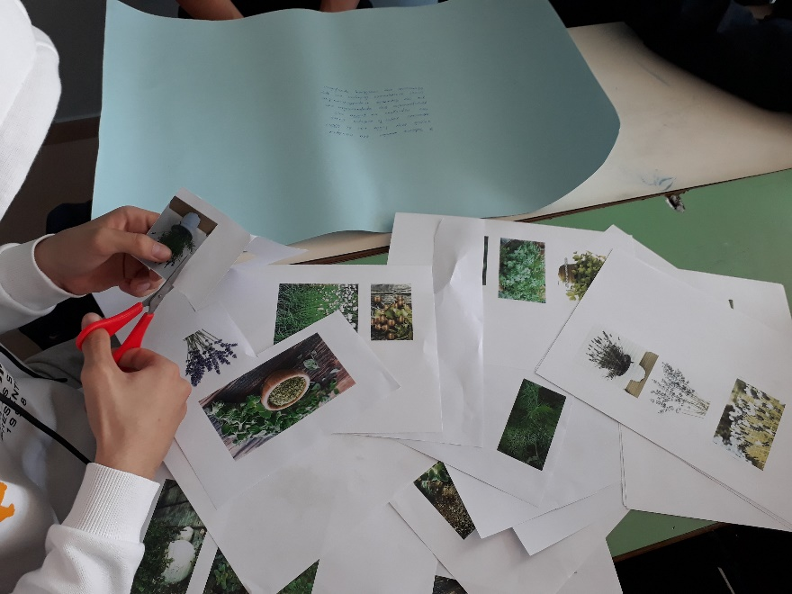
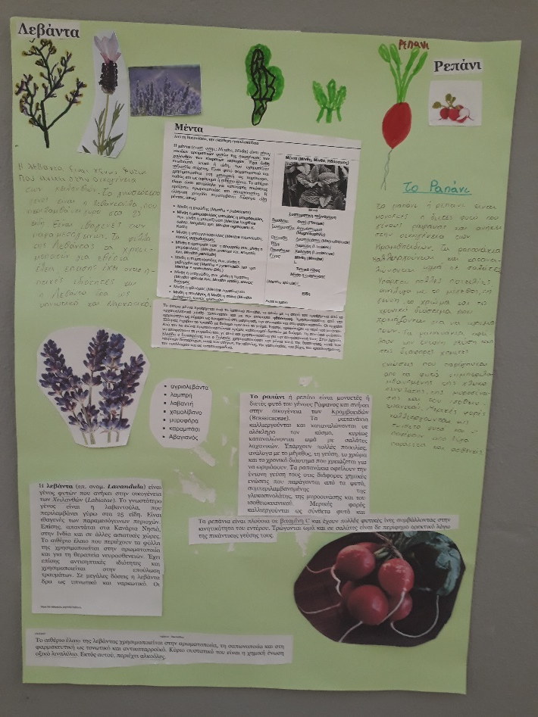
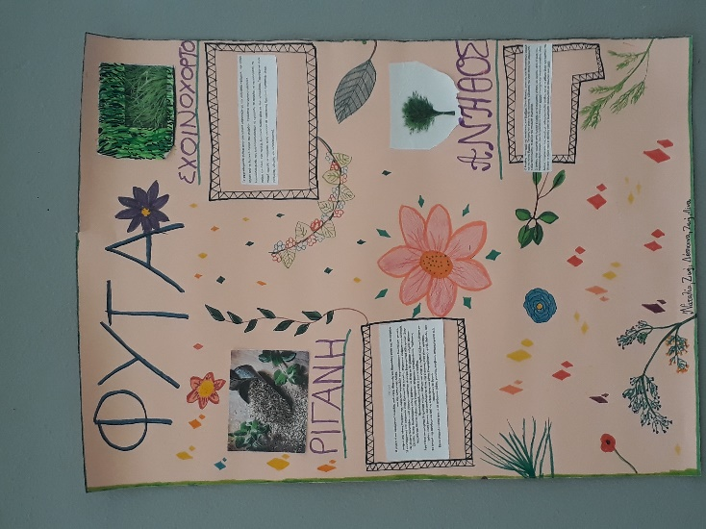
Learning about herbs

Slide 40
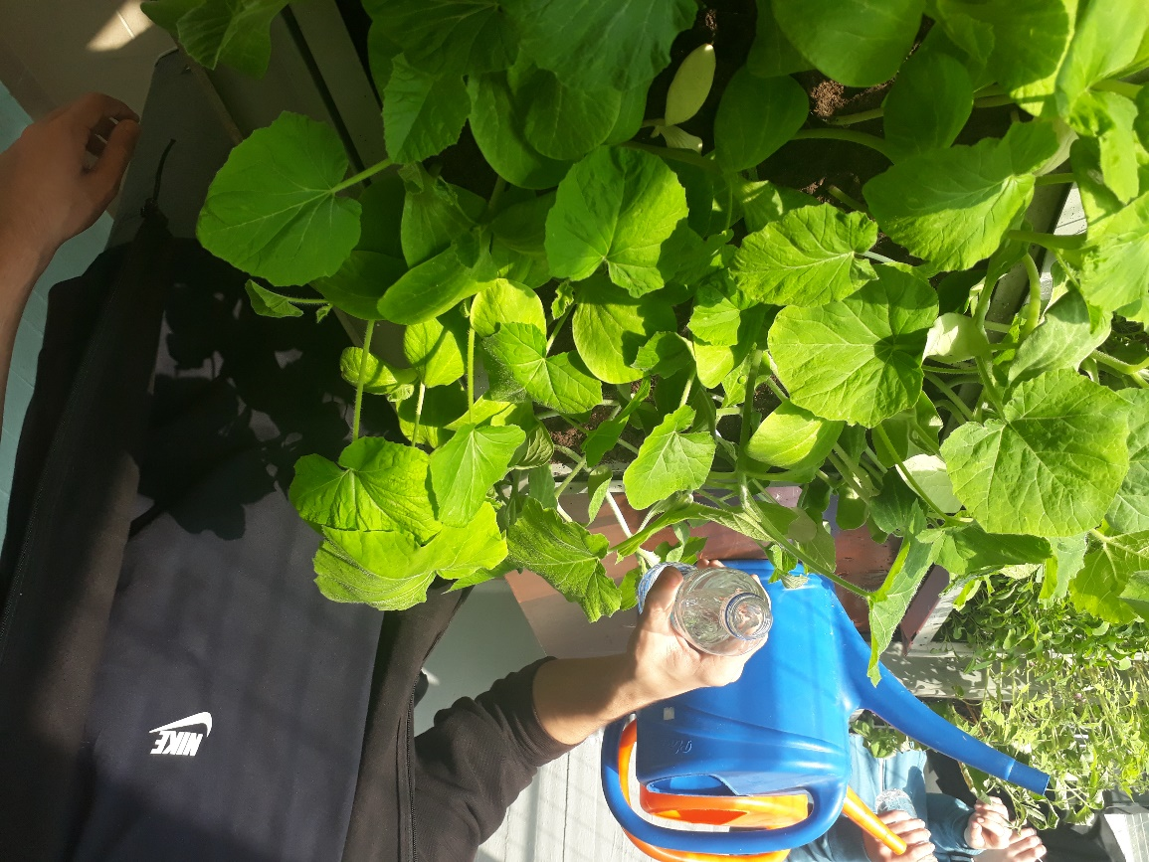
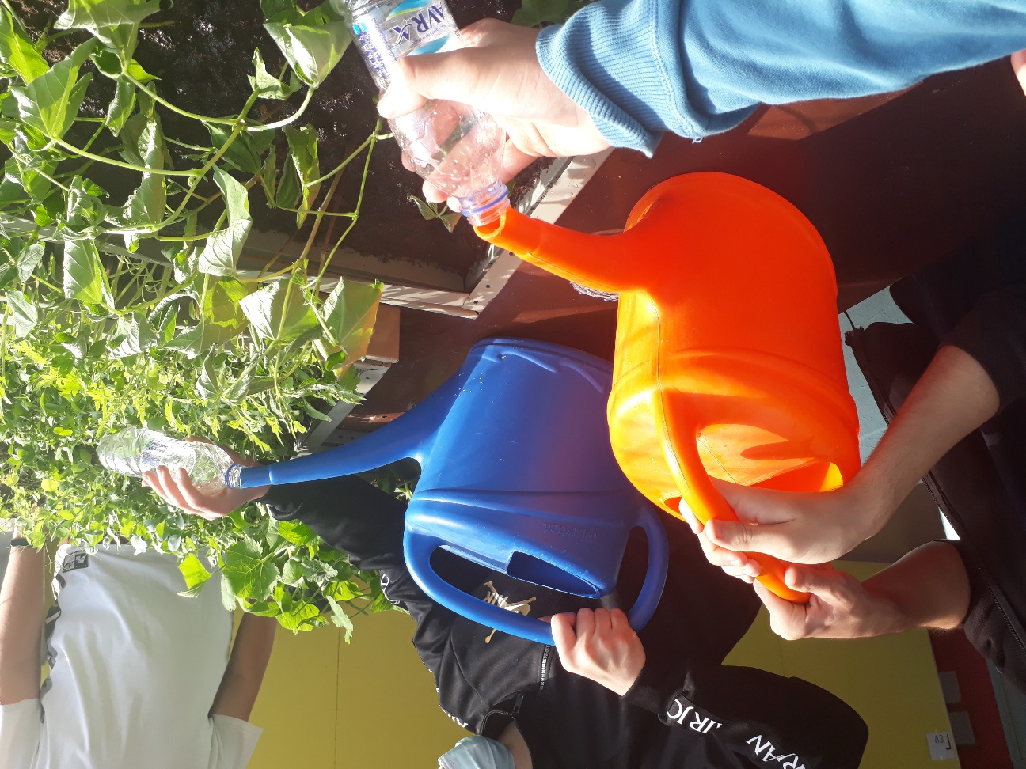
Taking care of our plant nursery

Slide 41
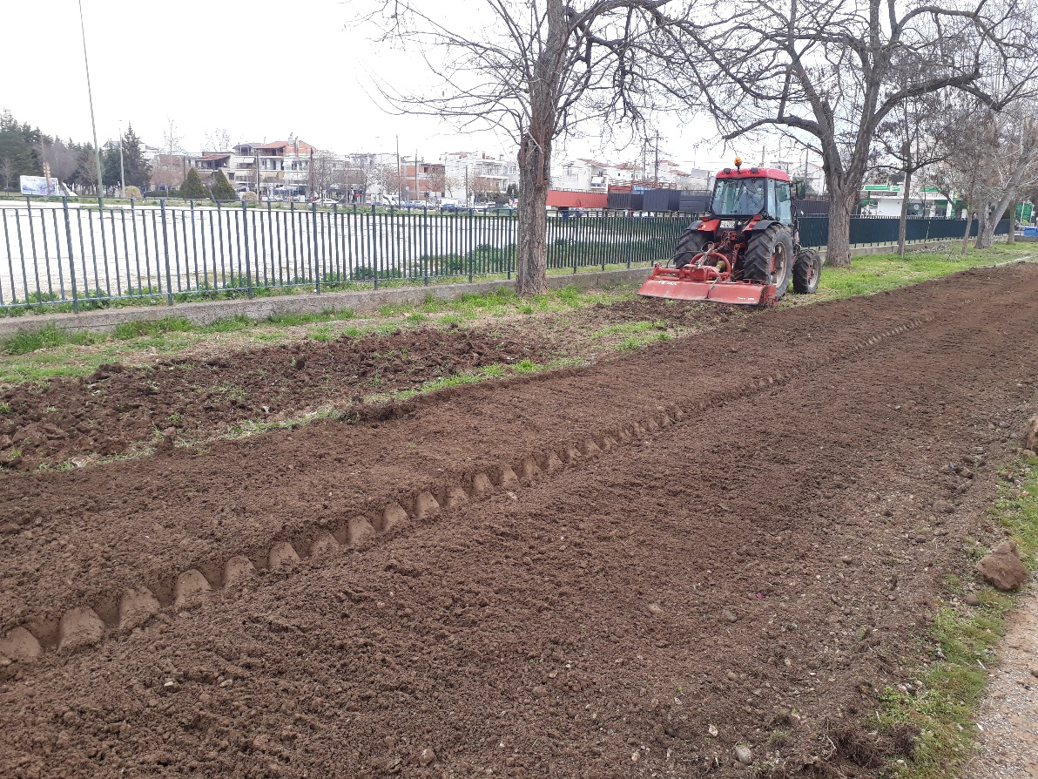
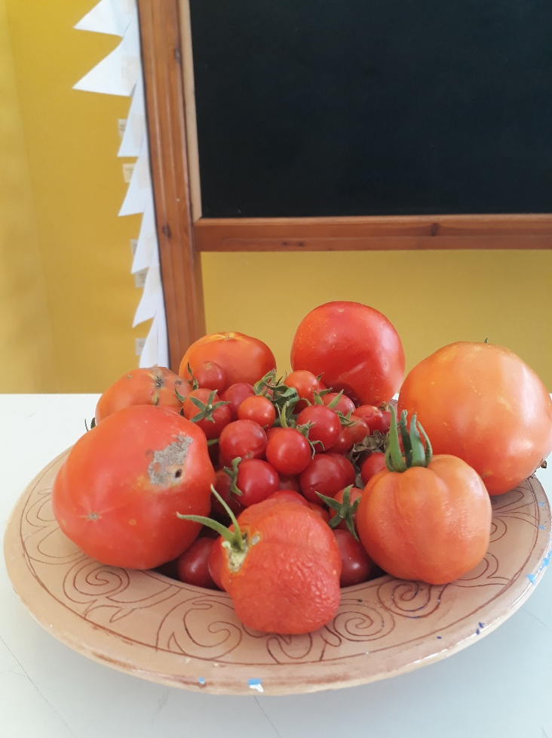
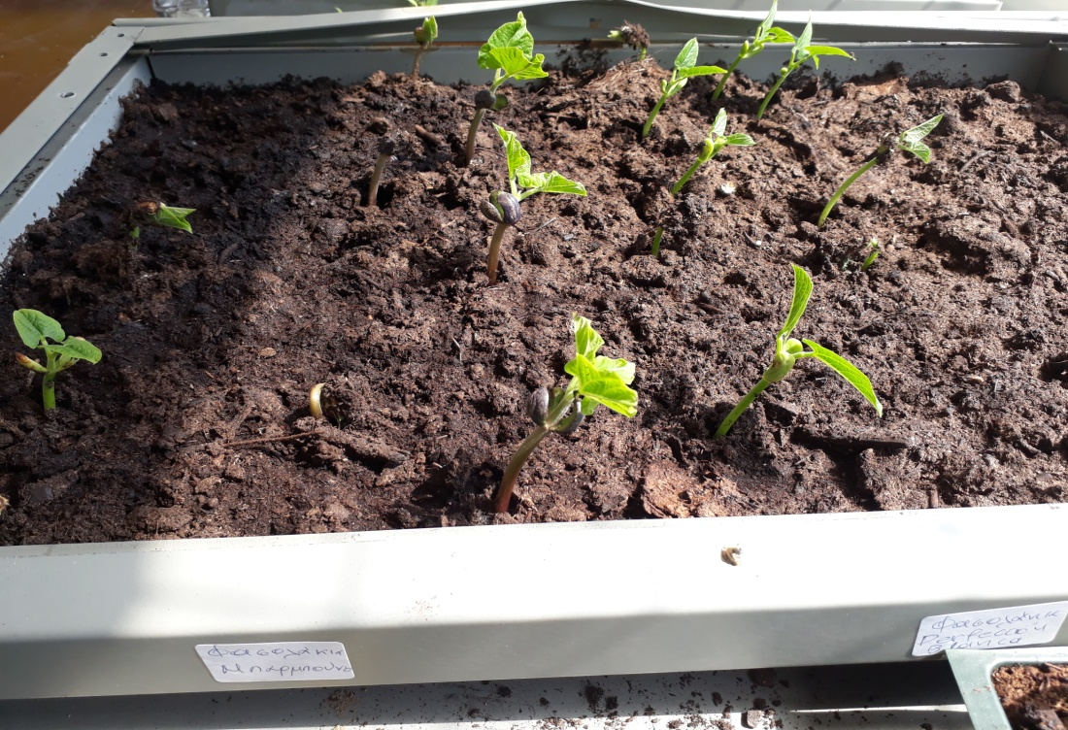
Our garden
Our products

Slide 42
Other activities

Slide 43
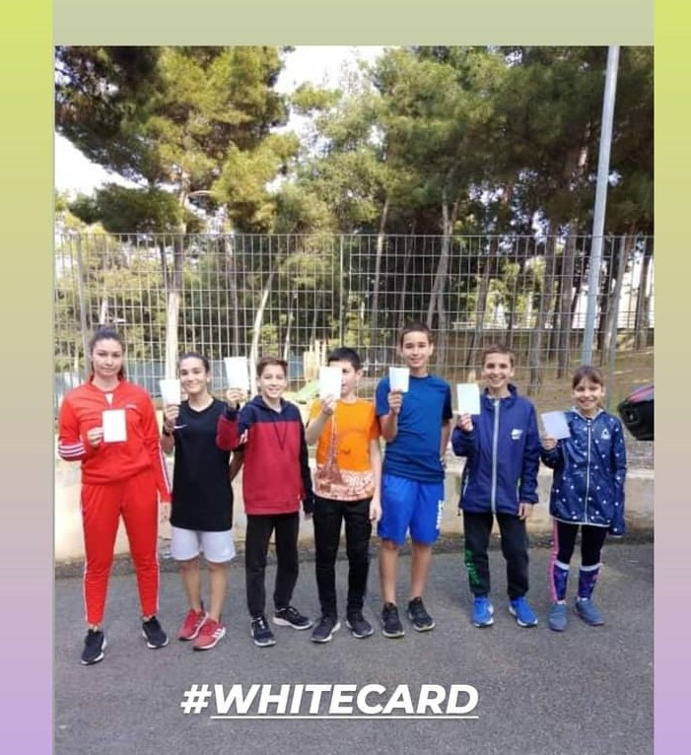
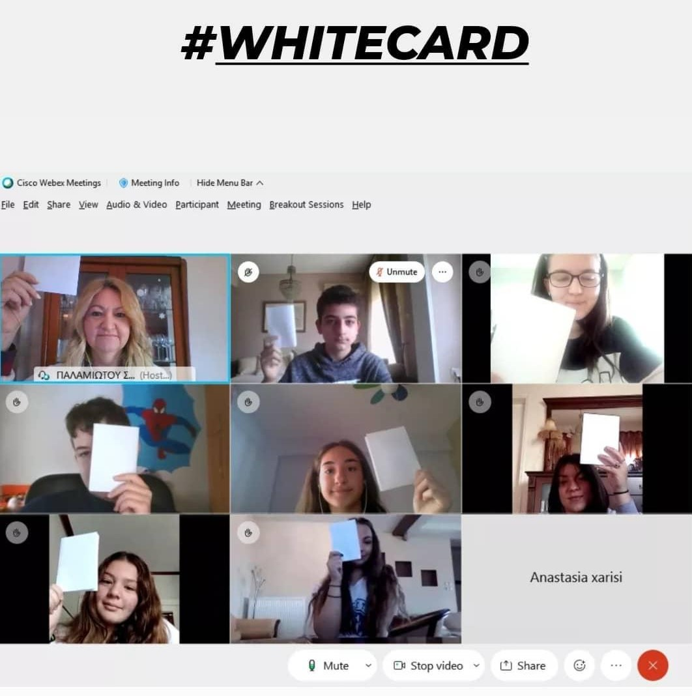
White Card campaign

Slide 44
Move Week

Slide 45
European Mobility Week

Slide 46
Christmas Bazaar
We sold handmade products
such as Christmas decorationswith recycled materials, soap, jewelry
and cakes.

Slide 47
Making soap with used olive oil

Slide 48
Celebrating sustainability
We took part in the national campaign for the
“17 goals of sustainable development”

Slide 49
Our school at the Holocaust Remembrance day

Slide 50
Human rights through role play
France 2018
Being a member of the national theater network which is under the guidance of the UNHCR in Greece
we can become aware of human rights and develop empathy for refugees
Theater and human rights

Slide 51
Folklore museum
Workshops about traditions and life in the past

Slide 52
European projects

Slide 53
Erasmus days 2019
During the ‘European Erasmus days 2019’
our school organized an event
for all the schools of our region
that implement Erasmus+ projects

Slide 54
e-Twinning projects
2015-17: A la recherche des traces de la
civilisation grecque ancienne dans la langue et
la société grecque et française d'aujourd'hui.
2017-19: La nouvelle Odyssée/ Η νέα Οδύσσεια
2018-20: STEPS to Tolerance for European Pupils
2019-21: Erasmus plus 2019-2021 "Our hands and
minds to become an active and responsible tourist
looking forward to promoting our own regions in the
future"
2019-21: Let's go increase skills of 21st century
2020-2022: Ma vie, ta vie, notre vie….

Slide 55
Erasmus+ projects
2017-19:De la Grèce à la France, le voyage dans tous ses états : voyager pour se découvrir soi-même, pour rencontrer les autres, pour travailler, pour sauver sa vie.
France-Greece
2018-20: STEPS to Tolerance for European Pupils
Romania, Italy, Lithuania, Spain, Portugal, Greece
2018-20: Over water
France, Bulgaria, Italy, Lithuania, Greece
2019-21: We eat healthily, we live happily
Portugal, Turkey, Italy, Greece
2019-21: Connection of health and daily routines
United Kingdom, Poland, Romania, Turkey, Greece

Slide 56
2019-21: Let's go increase skills of 21st century
Czech Republic, Portugal, Turkey, Italy, Greece
2020-21: Eco Life for Eco Environment for European
Citizens-4EU
Romania, Portugal, Spain, Turkey, Greece
2020-22: Garden of Cultures in Europe
Germany, Estonia, Spain, Greece
2020-21: Save the nature, save the future
Greece, Romania, Turkey, Portugal, Czech Republic
2020-21: Inspire
Italy, Romania, Estonia, Portugal, Greece
2019-2022: Our hands and minds to become an active and responsible tourist looking forward to promoting our own regions in the future
Poland, Greece, Latvia, Romania, Turkey

Slide 57
We enjoy working together!!!

